Slide 1
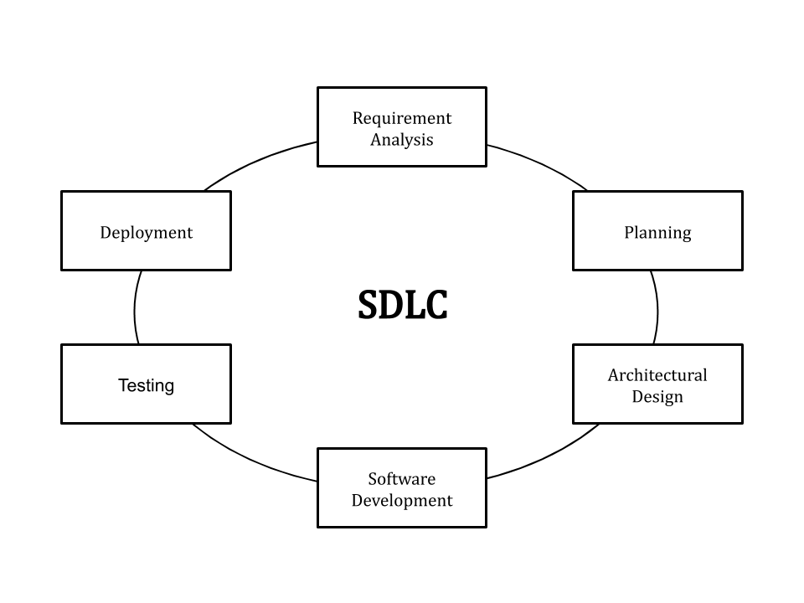
1. What is SDLC?
SDLC or the Software Development Life Cycle is a process that produces software with the highest quality and lowest cost in the shortest time possible. SDLC provides a well-structured flow of phases that help an organization to quickly produce high-quality software which is well-tested and ready for production use.

Slide 2
2. What is Waterfall?
The waterfall model is a linear, sequential approach to the software development lifecycle (SDLC) that is popular in software engineering and product development.
The waterfall model uses a logical progression of SDLC steps for a project, similar to the direction water flows over the edge of a cliff. It sets distinct endpoints or goals for each phase of development. Those endpoints or goals can't be revisited after their completion.

Slide 3
3. Different Models under SDLC?
Waterfall
RAD model
Spiral model
V-model
Incremental Model
Agile Model
Iterative Model
Bigbang Model

Slide 4
4. Different Models under Agile?
Kanban
Scrum
Extreme programming
Crystal
Dynamic systems development
Feature driven development
Lean software development methodology

Slide 5
5. What is UML?
UML, short for Unified Modeling Language, is a standardized modeling language consisting of an integrated set of diagrams, developed to help system and software developers for specifying, visualizing, constructing, and documenting the artifacts of software systems, as well as for business modeling and other non-software systems. The UML represents a collection of best engineering practices that have proven successful in the modeling of large and complex systems. The UML is a very important part of developing object-oriented software and the software development process. The UML uses mostly graphical notations to express the design of software projects. Using the UML helps project teams communicate, explore potential designs, and validate the architectural design of the software.

Slide 6
6. What is Architecture Diagram for Project?
An architecture diagram is a visual representation of all the elements that make up part, or all, of a system. Above all, it helps the engineers, designers, stakeholders — and anyone else involved in the project — understand a system or app’s layout.
Think of it as being a bit like a blueprint to a building: You can see the thing as a whole, as well as different kinds of interior views, and things like pipes, walls, floorplans, and so on.

Slide 7
7. What is Deployment Phase in SDLC?
The Deployment Phase in SDLC includes the work necessary to deploy the final solution into the target production environments. Plus, creating guides for installation, system operations, system administration, and end-user functionality.

Slide 8
8. Types under Agile
Kanban
Scrum
Extreme programming
Crystal
Dynamic systems development
Feature driven development
Lean software development methodology

Slide 9
9. What do you mean by Sprint in Agile Scrum?
A sprint is a short, time-boxed period when a scrum team works to complete a set amount of work. Sprints are at the very heart of scrum and agile methodologies, and getting sprints right will help your agile team ship better software with fewer headaches.

Slide 10
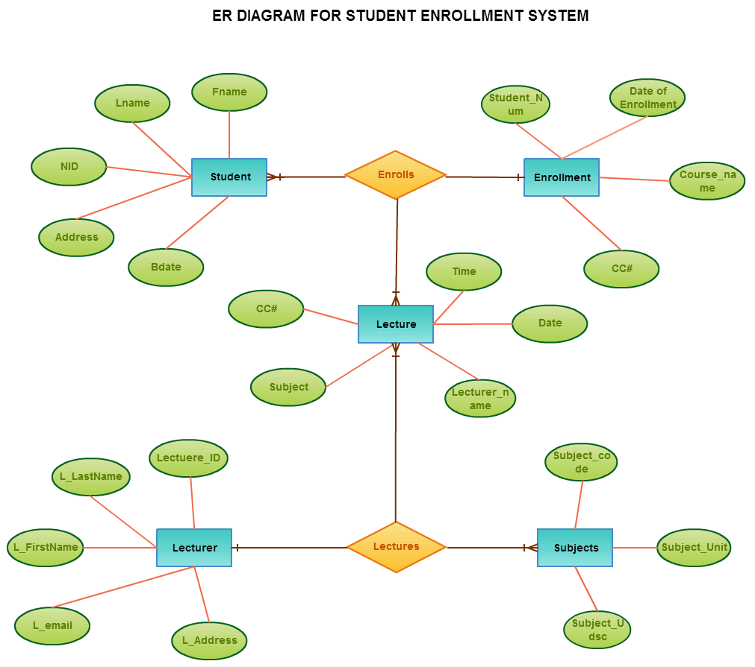
10. ER diagram?
An Entity Relationship Diagram (ERD) is a visual representation of different entities within a system and how they relate to each other. For example, the elements writer, novel, and a consumer may be described using ER diagrams the following way:

Slide 11
11. Difference between Waterfall and Agile Methodology?
Agile | Waterfall
It separates the project development lifecycle into sprints. | Software development process is divided into distinct phases.
It follows an incremental approach | Waterfall methodology is a sequential design process.
Agile methodology is known for its flexibility. | Waterfall is a structured software development methodology so most times it can be quite rigid.
Agile can be considered as a collection of many different projects. | Software development will be completed as one single project.
Agile is quite a flexible method which allows changes to be made in the project development requirements even if the initial planning has been completed. | There is no scope of changing the requirements once the project development starts.
Agile methodology, follow an iterative development approach because of this planning, development, prototyping and other software development phases may appear more than once. | All the project development phases like designing, development, testing, etc. are completed once in the Waterfall model.

